Slide 1
Introduction to CNN
Dr Mayada Hadhoud
Notes:
Edited by Dr Mayada Hadhoud Fall2017
CMPN446 Image Processing and Computer Vision
Fall 2012
1

Slide 2
Overview
Classical Computer Vision Pipeline
KNN Classifier
Neural Network
Convolutional Neural Networks
CNNs Architectures

Slide 3
Acknowledge
Most of the slides are taken from
Computer Vision: Foundations and Applications Course. Stanford Vision and Learning Lab

Slide 4
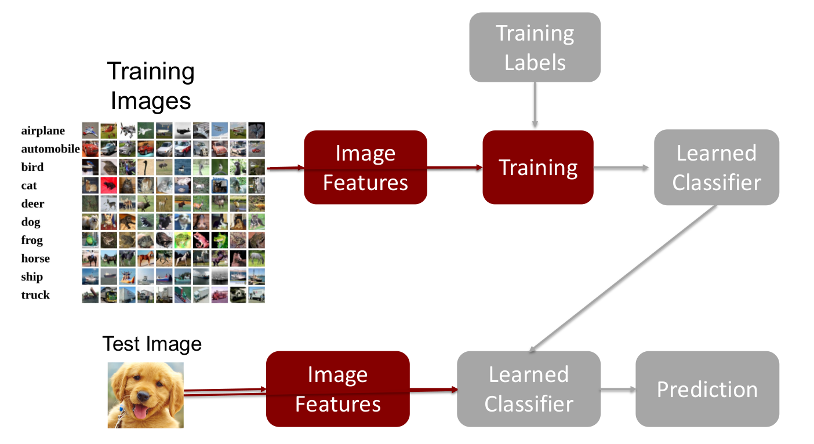
Introduction
Classical Computer Vision Pipeline
Notes:
Source :http://courses.cs.tau.ac.il/Caffe_workshop/Bootcamp/Lecture%201%20CNN%20introduction.pptx
CMPN446 Image Processing and Computer Vision
Fall 2012
4

Slide 5
Introduction
Data acquisition and sensing
Pre-processing
Removal of noise in data
Isolation of patterns of interest from the background.
Feature extraction
Model learning and estimation
Learning a mapping between features and pattern groups.
Classification
Using learned models to assign a pattern to a predefined category
Post-processing
Evaluation of confidence in decisions
Exploitation of context to improve performances.

Slide 6
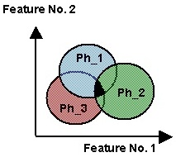
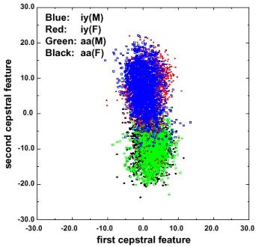
Introduction
Regions of overlap represent classification error
Reduce overlap by introducing acoustic and linguistic context
Notes:
6

Slide 7
Nearest Neighbour Classification
The idea is to estimate the classification of an unseen instance using the classification of the instance or instances that are closest to it, in some sense that we need to define.
Pattern Classification
7

Slide 8
K-Nearest Neighbour (K-NN)
Find the k training instances that are closest to the unseen instance.
Take the most commonly occurring classification for these k instances.
k is a small integer such as 3 or 5
Pattern Classification
8

Slide 9
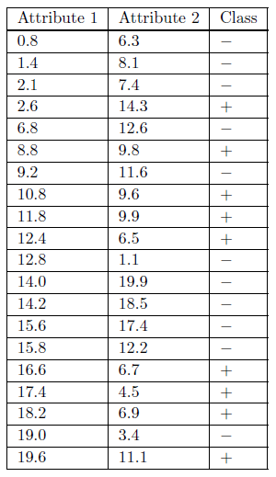
Training Data Set
Two classes
Two attributes
How to classify (9.1,11)
Pattern Classification
9

Slide 10
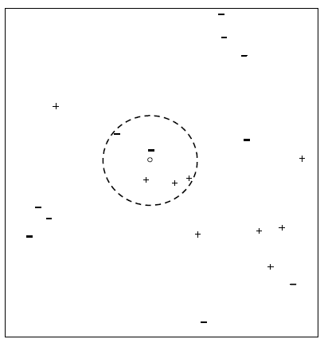
5-NN Classifier
The five nearest neighbours are labeled with three + signs and two − signs,
so a basic 5-NN classifier would classify the unseen instance as ‘positive’ by a form of majority voting.
Pattern Classification
10

Slide 11
K-Nearest Neighbor
k = 1:
Belongs to square class
k = 3:
Belongs to triangle class
?
k = 7:
Belongs to square class
Choosing the value of k:
If k is too small, sensitive to noise points
If k is too large, neighborhood may include points from other classes
Choose an odd value for k, to eliminate ties
11

Slide 12
Neural Networks
An Artificial Neural Network (ANN) is an information processing paradigm that is inspired by the biological nervous systems, such as the human brain’s information processing mechanism.
It is composed of a large number of highly interconnected processing elements (neurons) working in unison to solve specific problems.

Slide 13
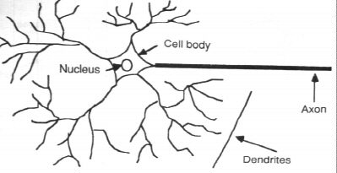
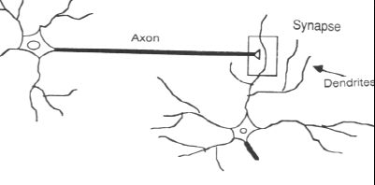
In the human brain, a typical neuron collects signals from others through a host of fine structures called dendrites.
The neuron sends out spikes of electrical activity through a long, thin stand known as an axon, which splits into thousands of branches.
At the end of each branch, a structure called a synapse converts the activity from the axon into electrical effects that inhibit or excite activity in the connected neurons.
How the Human Brain learns

Slide 14
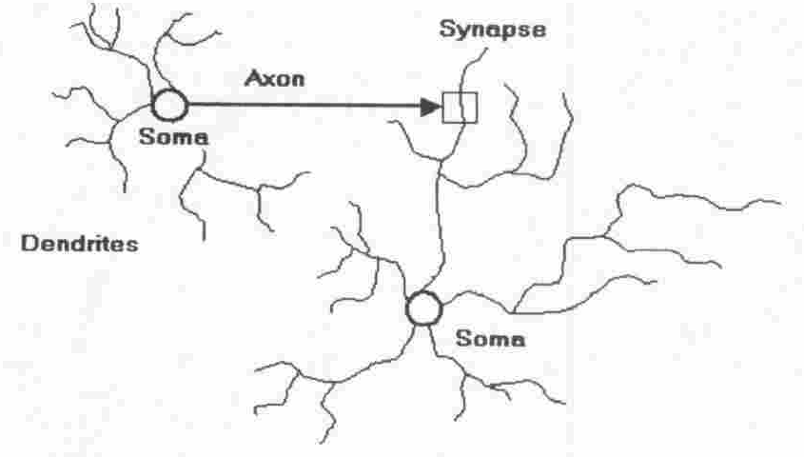
Four basic components of a human biological neuron
The components of a basic artificial neuron

Slide 15
Model Of A Neuron
W_{a}
X₁
μ
W_{b}
f(μ)
Y
X₂
W_{c}
X₃
Input units
Connection weights
Summing function
computation
(dendrite)
(synapse)
(axon)
(soma)
Notes:
15

Slide 16
A neural net consists of a large number of simple processing elements called neurons, units, cells or nodes.
Each neuron is connected to other neurons by means of directed communication links, each with associated weight.
The weight represent information being used by the net to solve a problem.
Each neuron has an internal state, called its activation or activity level, which is a function of the inputs it has received. Typically, a neuron sends its activation as a signal to several other neurons.
It is important to note that a neuron can send only one signal at a time, although that signal is broadcast to several other neurons.
Neural networks are configured for a specific application, such as pattern recognition or data classification, through a learning process
Notes:
16

Slide 17
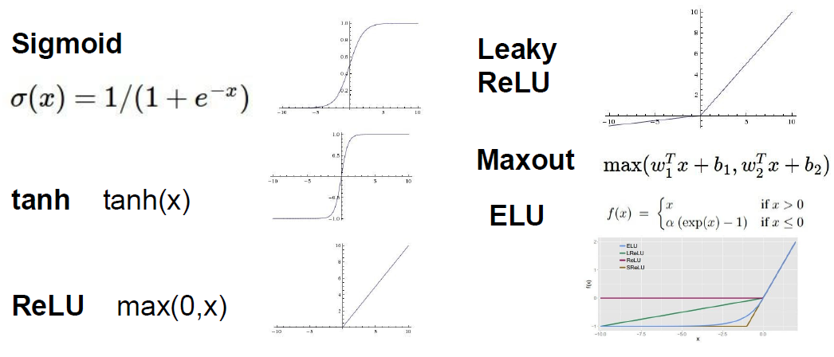
Activation Functions
Notes:
ReLU
(Rectified Linear Unit)
- Very computationally efficient
Converges much faster than
In practice :
Use ReLU. Be careful with your learning rates
- Try out Leaky ReLU / Maxout / ELU
- Try out tanh but don’t expect much
- Don’t use sigmoid
CMPN446 Image Processing and Computer Vision
Fall 2012
17

Slide 18
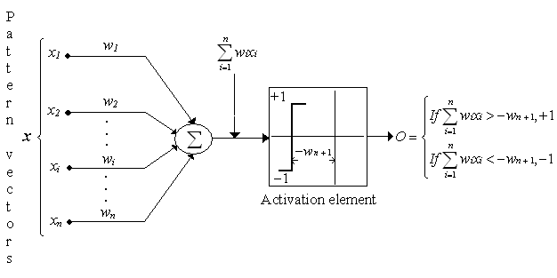
Neural Networks
Perceptron : two classes model
Structure of perceptron

Slide 19
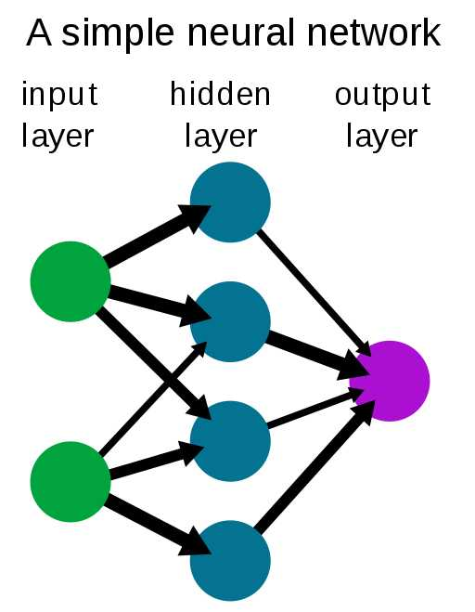

Slide 20
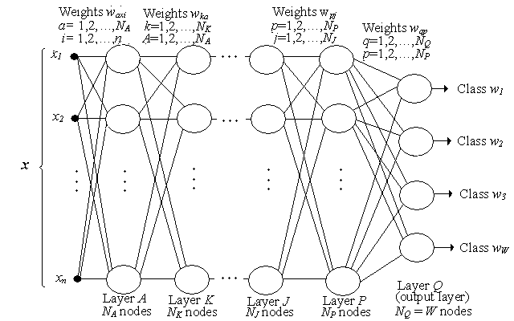
Neural Networks : Multilayer Feedforward Neural Networks
Basic structure
Structure of multi layer feedforward neural networks

Slide 21
Training Basics
The most basic method of training a neural network is trial and error.
If the network isn't behaving the way it should, change the weighting of a random link by a random amount. If the accuracy of the network declines, undo the change and make a different one.
It takes time, but the trial and error method does produce results.

Slide 22
Training: Back propagation algorithm
The Backprop algorithm searches for weight values that minimize the total error of the network over the set of training examples (training set).
Backprop consists of the repeated application of the following two passes:
Forward pass: in this step the network is activated on one example and the error of (each neuron of) the output layer is computed.
Backward pass: in this step the network error is used for updating the weights. Starting at the output layer, the error is propagated backwards through the network, layer by layer. This is done by recursively computing the local gradient of each neuron.

Slide 23
Back Propagation
Back-propagation training algorithm
Backprop adjusts the weights of the NN in order to minimize the network total mean squared error.
Network activation
Forward Step
Error propagation
Backward Step

Slide 24
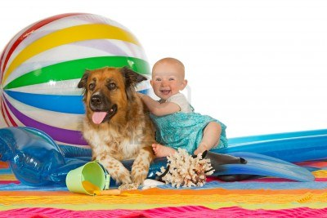
Classical Computer Vision Pipeline.
CV experts
Select / develop features: SURF, HoG, SIFT, RIFT,
Add on top of this Machine Learning for multi-class recognition and train classifier
Feature
Extraction:
SIFT, HoG...
Detection,
Classification
Recognition
Classical CV feature definition is domain-specific and time-consuming
Notes:
Source :http://courses.cs.tau.ac.il/Caffe_workshop/Bootcamp/Lecture%201%20CNN%20introduction.pptx

Slide 25
Deep Learning –based Vision Pipeline
Deep Learning:
Build features automatically based on training data
Combine feature extraction and classification
DL experts: define NN topology and train NN
Deep NN...
Deep NN...
Detection,
Classification
Recognition
Deep Learning promise:
train good feature automatically,
same method for different domain

Slide 26
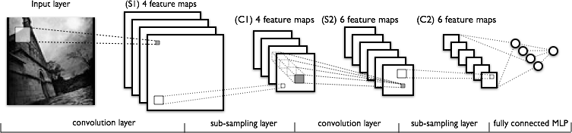
Convolutional NN(CNN)
CNN is a multilayered neural network with a special architecture to detect complex features in data.
Feature Extraction
Classi-
fication

Slide 27
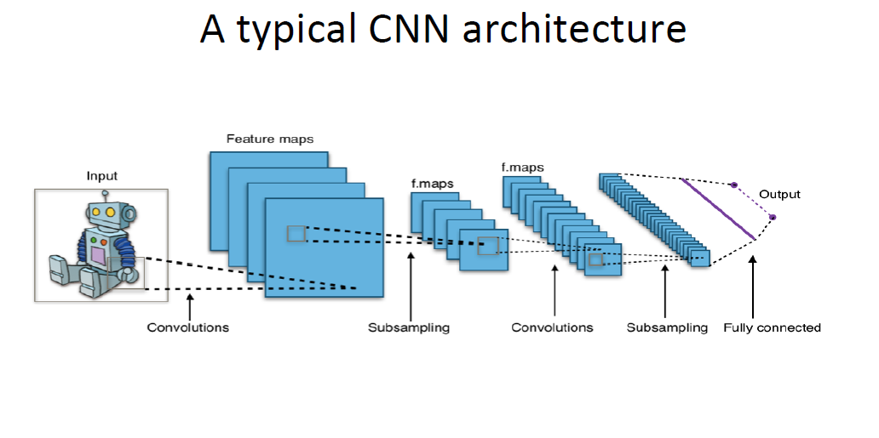

Slide 28
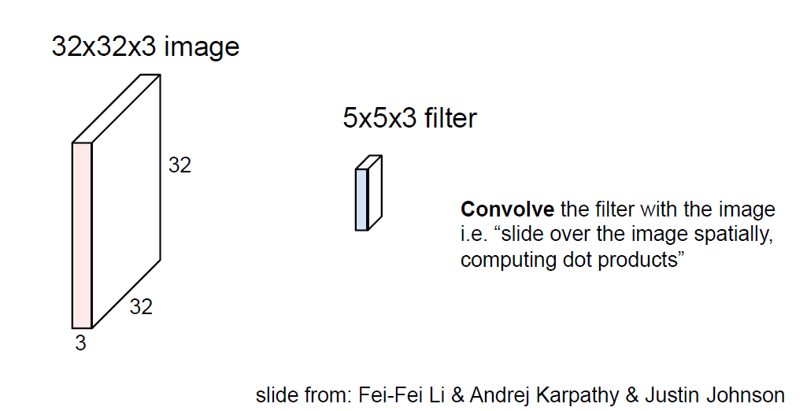
Convolution Layers

Slide 29
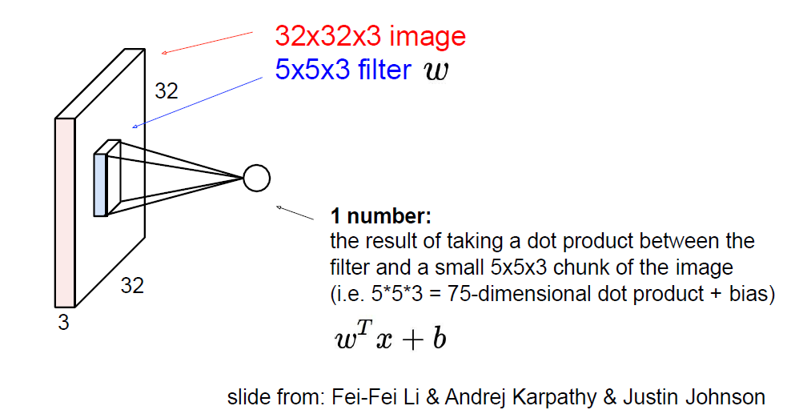
Convolution Layers

Slide 30
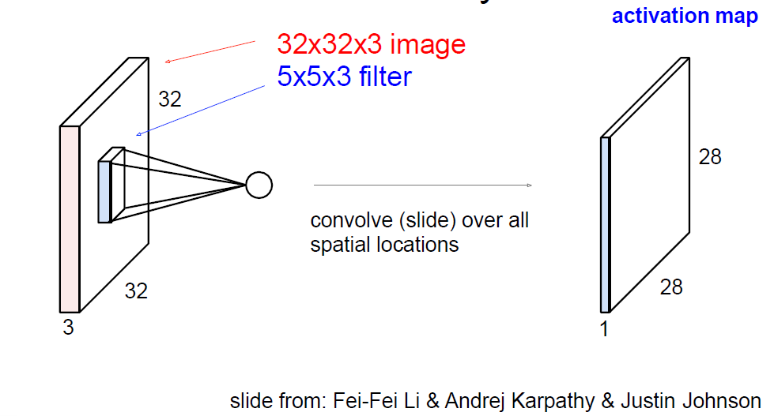
Convolution Layers

Slide 31
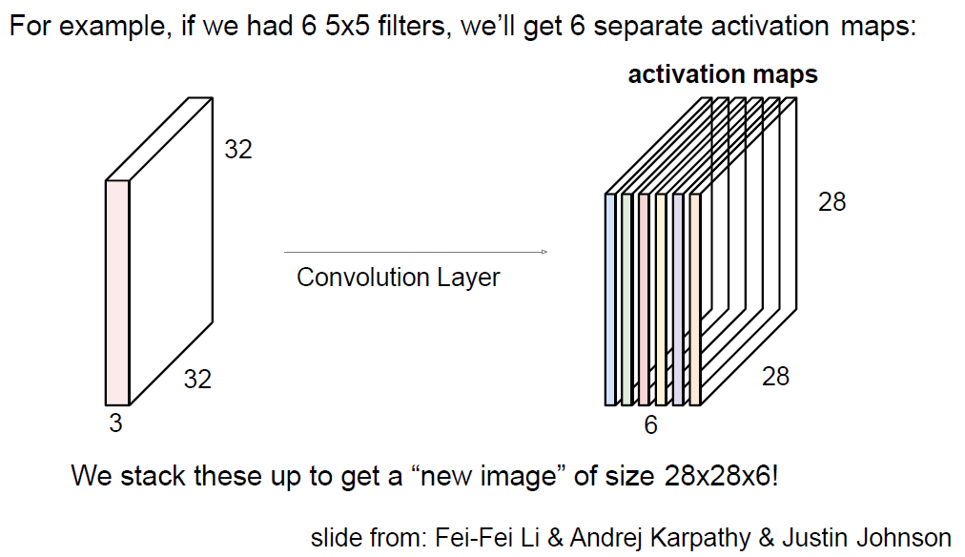
Convolution Layers

Slide 32
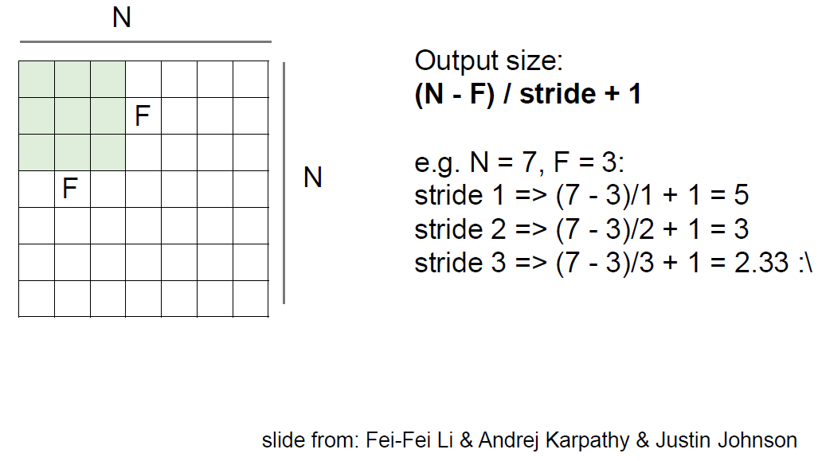
Convolution Layers

Slide 33
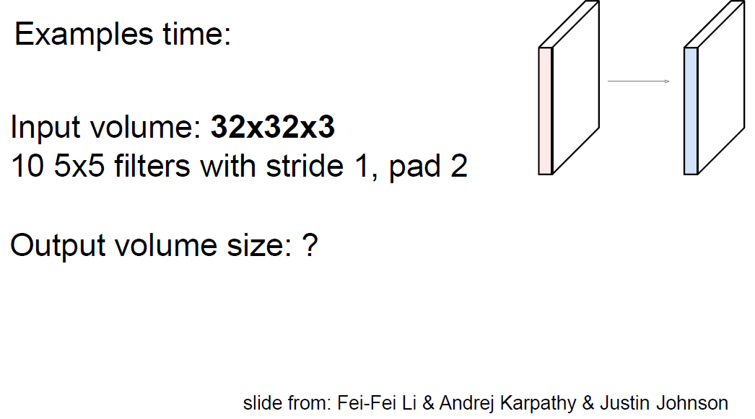

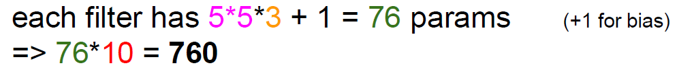
Convolution Layers
Notes:
Output volume size: (32+2*2-5)/1+1 = 32 spatially, so
32x32x10
CMPN446 Image Processing and Computer Vision
Fall 2012
33

Slide 34
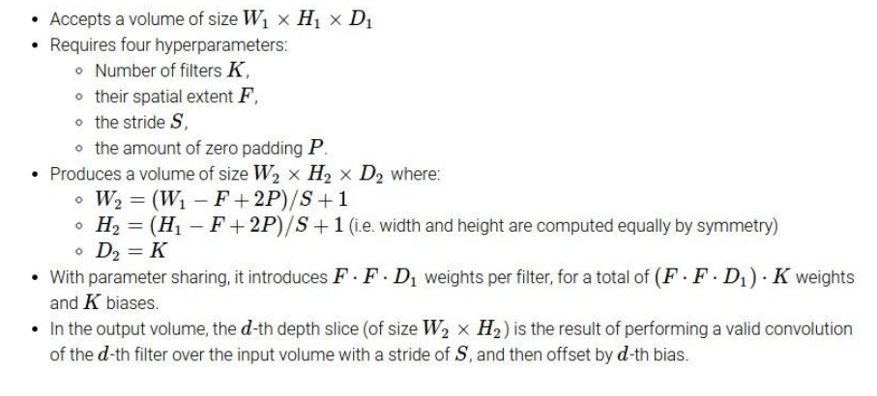
Convolution Layers Summary
Notes:
slide from: Fei-Fei Li & Andrej Karpathy & Justin Johnson
CMPN446 Image Processing and Computer Vision
Fall 2012
34

Slide 35
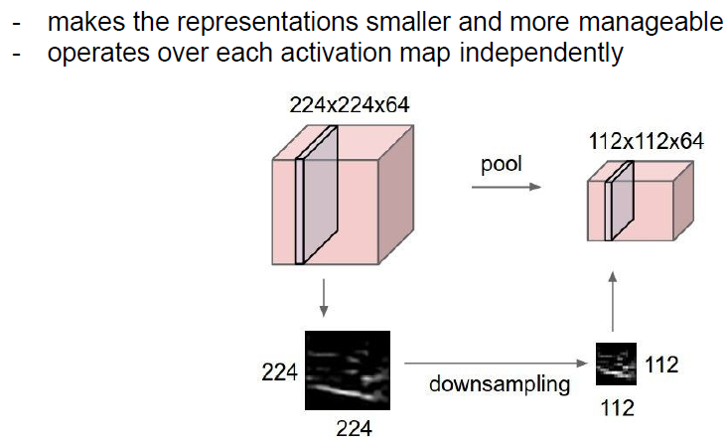
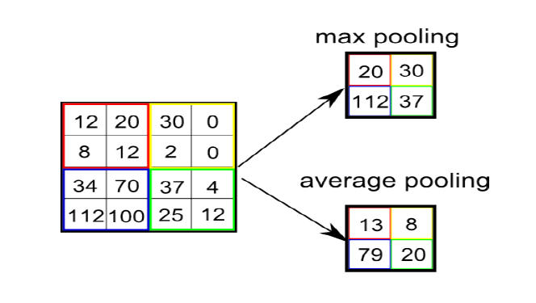
Pooling Layers

Slide 36
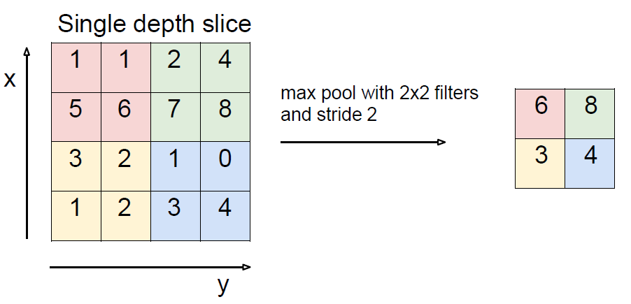
Pooling Layer

Slide 37
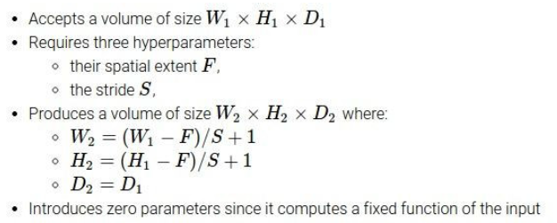
Pooling Layers Summary

Slide 38

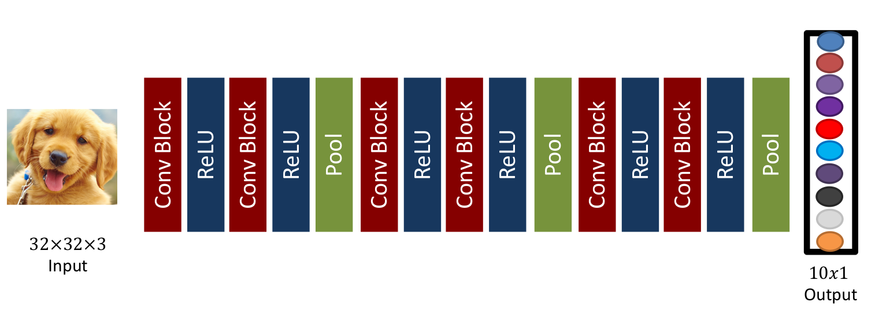

Slide 39
AlexNet Example [Krizhevsky et al. 2012]
Input: 227x227x3 images
First layer (CONV1): 96 11x11 filters applied at stride 4
What is the output volume size?
Output volume [55x55x96]
What is the total number of parameters in this layer?
(11*11*3)*96 = 35K
Second layer (POOL1): 3x3 filters applied at stride 2
What is the output volume size?
27x27x96
What is the number of parameters in this layer?

Slide 40
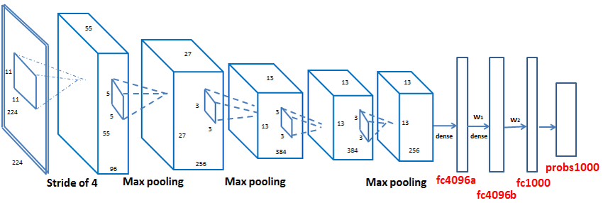
AlexNet Archiecture[Krizhevsky et al. 2012]

Slide 41
AlexNet Example [Krizhevsky et al. 2012]
Full (simplified) AlexNet architecture:
[227x227x3] INPUT
[55x55x96] CONV1: 96 11x11 filters at stride 4, pad 0
[27x27x96] MAX POOL1: 3x3 filters at stride 2
[27x27x96] NORM1: Normalization layer
[27x27x256] CONV2: 256 5x5 filters at stride 1, pad 2
[13x13x256] MAX POOL2: 3x3 filters at stride 2
[13x13x256] NORM2: Normalization layer
[13x13x384] CONV3: 384 3x3 filters at stride 1, pad 1
[13x13x384] CONV4: 384 3x3 filters at stride 1, pad 1
[13x13x256] CONV5: 256 3x3 filters at stride 1, pad 1
[6x6x256] MAX POOL3: 3x3 filters at stride 2
[4096] FC6: 4096 neurons
[4096] FC7: 4096 neurons
[1000] FC8: 1000 neurons (class scores)

Slide 42
The ImageNet Large Scale Visual Recognition Challenge (ILSVRC)
a benchmark in object category classification and detection on hundreds of object categories and millions of images. The challenge has been run annually from 2010 to present.
ILSVRC is an annual competition that uses subsets from the ImageNet dataset and is designed to foster the development and bench-marking of state-of-the-art algorithms.
1,461,406 in ILSVRC 2010, 1000 Category
The annual challenge focuses on multiple tasks for “image classification” that includes both assigning a class label to an image based on the main object in the photograph and “object detection” that involves localizing objects within the photograph.

Slide 43
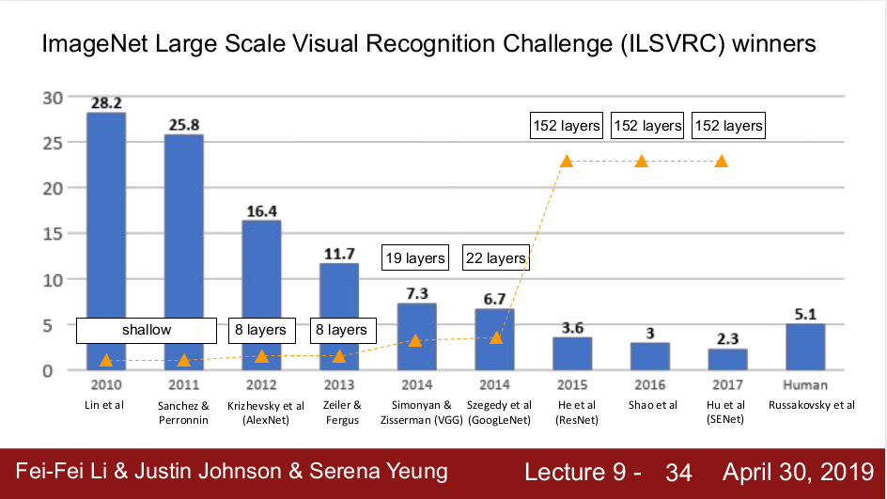

Slide 44
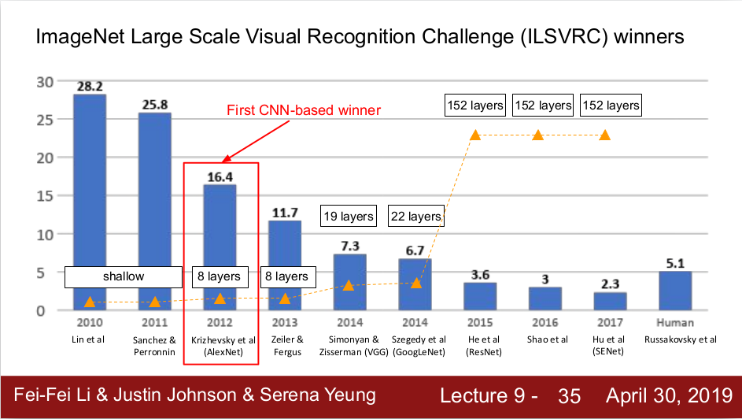

Slide 45
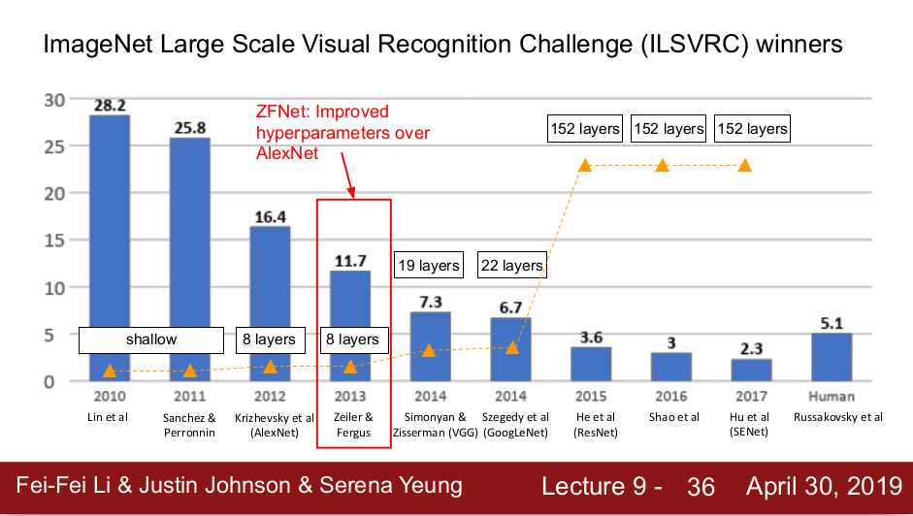
AlexNet but:
CONV1: change from (11x11 stride 4) to (7x7 stride 2)
CONV3,4,5: instead of 384, 384, 256 filters use 512, 1024, 512

Slide 46
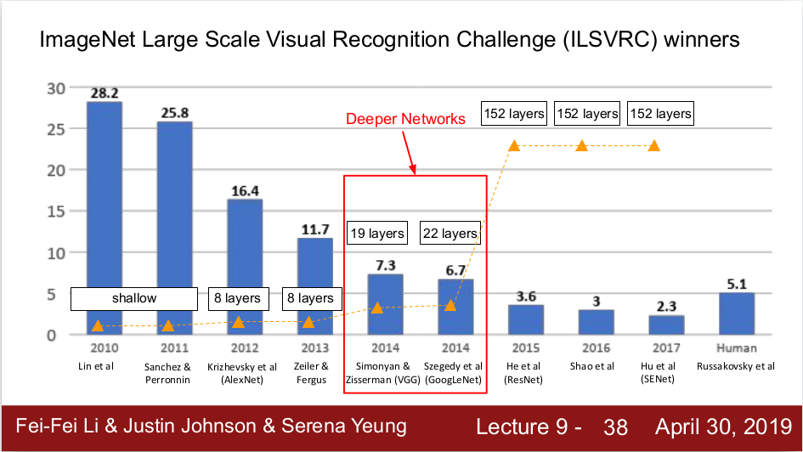

Slide 47
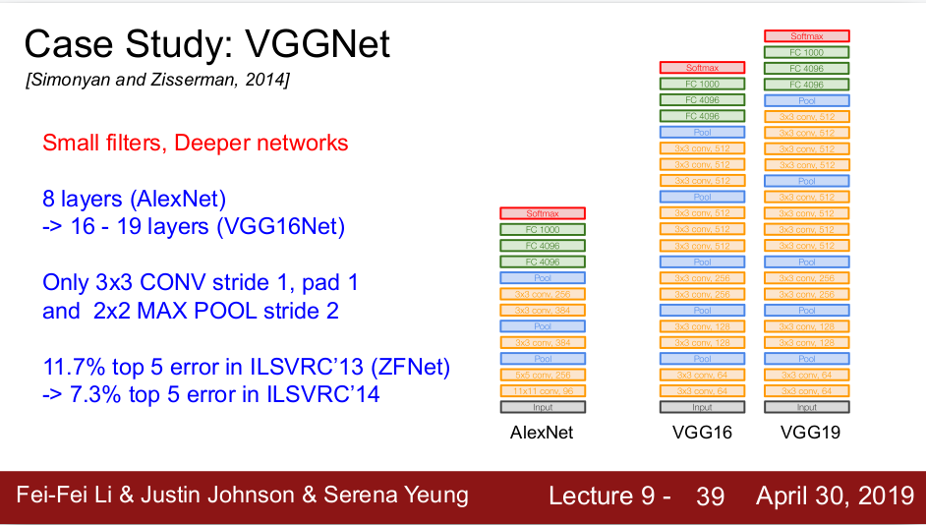

Slide 48
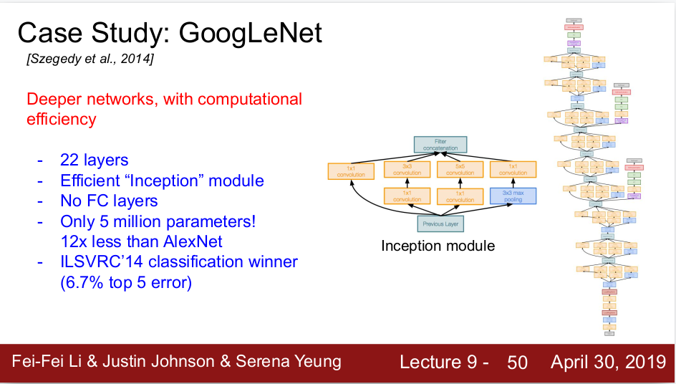
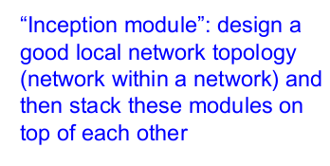

Slide 49
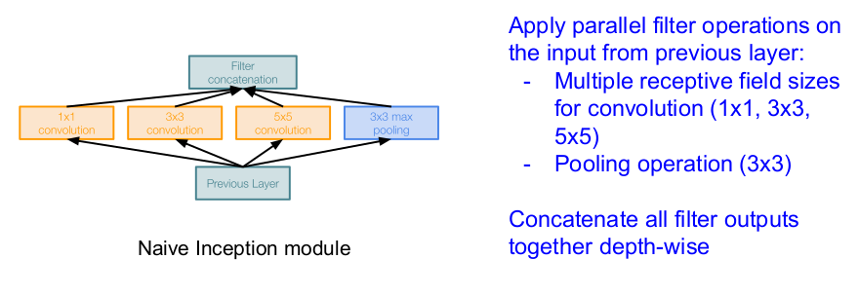
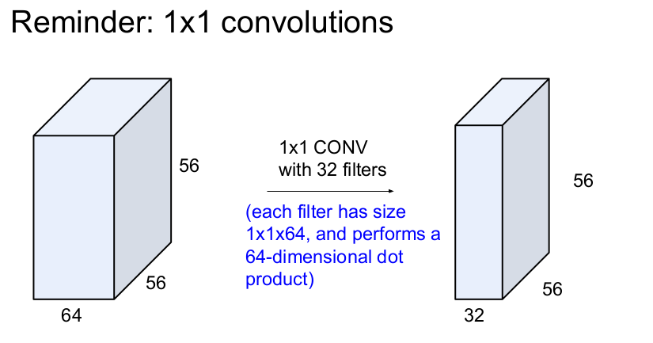


Slide 50
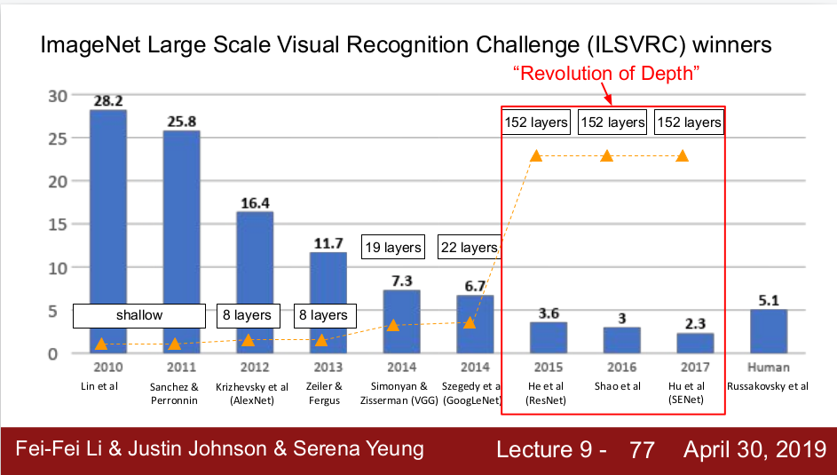

Slide 51
